Slide 1
DATA 300 RECAP
Statistical and Machine Learning

Slide 2
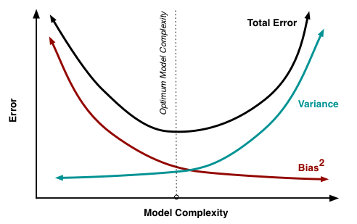
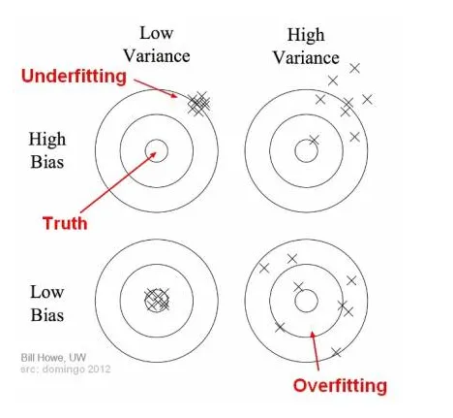

Bias-variance Trade-off
Bias: Bias is the difference between the average prediction of our model and the correct value which we are trying to predict.
Variance: Variance is the variability of model prediction for a given data point or a value which tells us spread of our data.
High bias: Underfitting
High variance: Overfitting
To build a good model, we need to find a good balance between bias and variance such that it minimizes the total error.

Slide 3
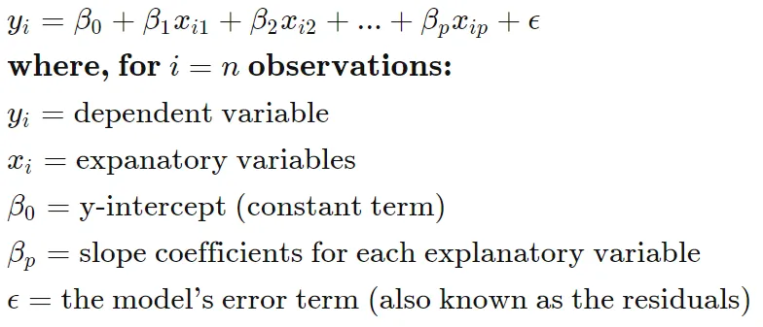
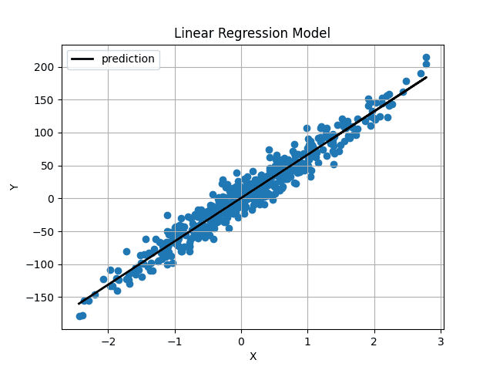
Linear Regression
Linear regression models the relationship between the independent variable (feature) and the dependent variable (target) as a linear equation.

Slide 4
Linear Regression
Assumption:
Linearity: This is the foundation. It assumes there's a straight-line relationship between the independent variable (X) and the dependent variable (Y).
Independence: This means the errors (residuals) between the actual data points and the regression line are independent of each other.
Homoscedasticity (Constant Error Variance): The spread of the residuals should be constant across all levels of the independent variable.
Normality: Ideally, the residuals should be normally distributed around the mean (usually zero).

Slide 5
Linear Regression
Question:
What are the advantages and disadvantages of linear regression?

Slide 6
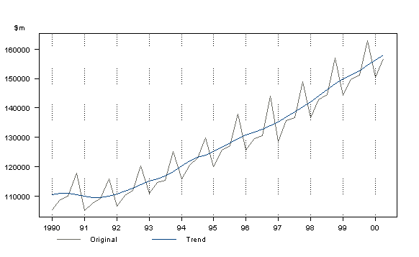
Time Series
A time series is simply a series of data points ordered in time. In a time series, time is often the independent variable and the goal is usually to make a forecast for the future.

Slide 7
Components of Time Series
Time series data can be broken down into several components, including trend, seasonality, stationary and random noise. The model attempts to capture these components and their interactions.
Trend:
Represents the long-term upward or downward movement in the data. It can be linear (straight line), non-linear (curved line), or even flat (no change) over time.
Seasonality:
Refers to repetitive patterns that occur at fixed intervals within a specific time period. This interval could be daily, weekly, monthly, yearly, or even seasonal variations within a year (e.g., higher ice cream sales in summer).
Random Noise:
Captures the unexplained fluctuations or irregular variations in the data. These random variations cannot be systematically predicted and are often attributed to chance events or factors outside the scope of the model.
Stationarity:
Time series data can be classified into stationary and non-stationary. Stationarity is an important property, as some models relies on the assumption that data is stationary.

Slide 8
Common Time Series Models
ARMA: Autoregressive + Moving Average
ARMA stands for Autoregressive Moving Average. As the name suggests, it is a combination of two parts – Autoregressive and Moving Average.
ARIMA: Autoregressive + Moving Average + Trend Differencing
ARIMA stands for Autoregressive Integrated Moving Average, which extends from ARMA model and incorporates the integrated component (inverse of differencing).

Slide 9
Advantages of ARMA model
Flexible:
ARMA models can be flexible in capturing both short-term dependencies through the MA part and long-term dependencies through the AR part, providing a good balance for various time series patterns.
Useful for Noise Filtering:
The moving average component helps in filtering out short-term fluctuations or noise, making it useful for smoothing and highlighting underlying trends.
Interpretability:
The model parameters have clear interpretations. The AR component represents the influence of past values on the current value, while the MA component captures the impact of past forecast errors.

Slide 10
Advantages of ARIMA model
Handles Non-Stationary Data:
ARIMA models include an integration (I) component, which allows them to handle non-stationary time series data by differencing the observations. This makes ARIMA suitable for a broader range of datasets.
Seasonal Adjustment:
ARIMA models can incorporate seasonality through differencing. Seasonal patterns can be addressed by including a seasonal difference in the model, making it suitable for data with repeating patterns.
Effective Forecasting:
ARIMA models can provide accurate short-term forecasting by considering both autoregressive and moving average components.

Slide 11
Real-world examples
Stock price prediction
Energy consumption forecasting
Sales prediction

Slide 12
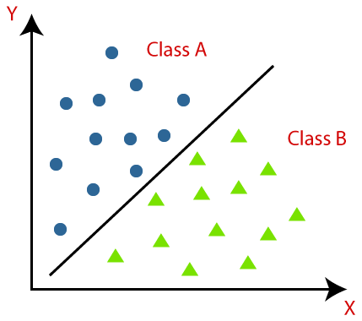
Linear Classification
Linear classification is a method for categorizing data points into a discrete class based on a linear combination of its explanatory variables.
.

Slide 13
Different types of linear classifiers
Logistic regression
The naive Bayes classifier
The linear support vector classifier (SVC)

Slide 14
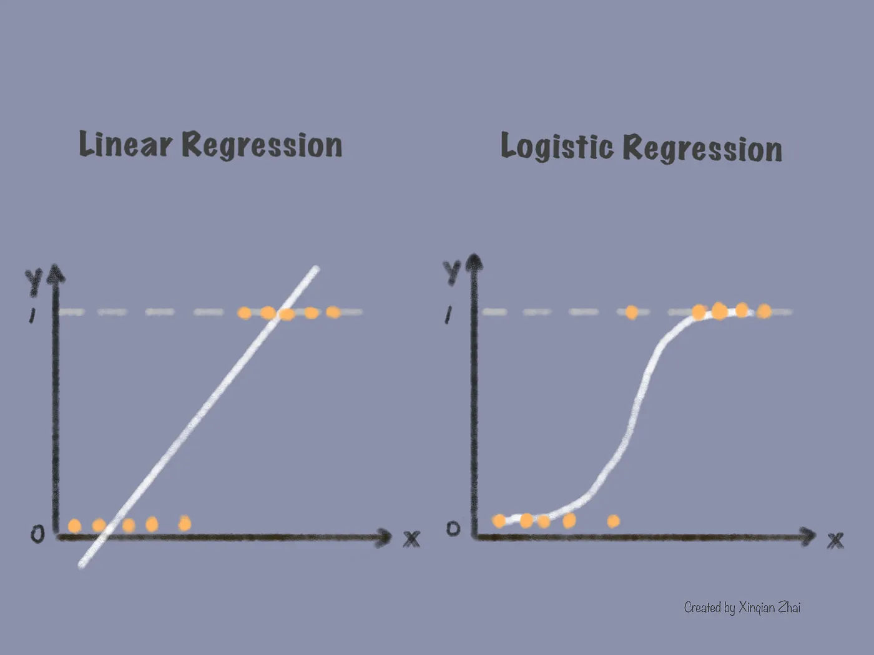
Logistic Regression
Logistic regression is a classifier for predicting the probability of binary output values. It limits the output value to a range between 0 and 1 and produces an S-shaped logistic curve.

Slide 15
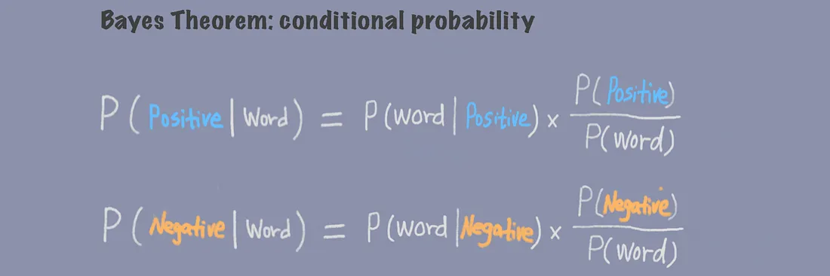
Naive Bayes Classifier
A naive Bayes classifier is also a probabilistic classifier that solves classification problems based on Bayes’ theorem.

Slide 16
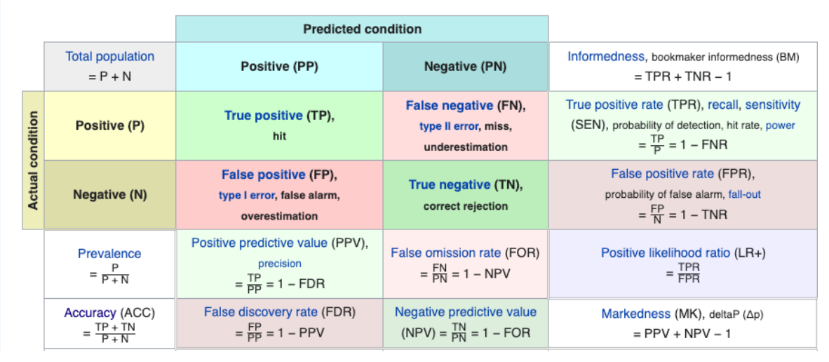
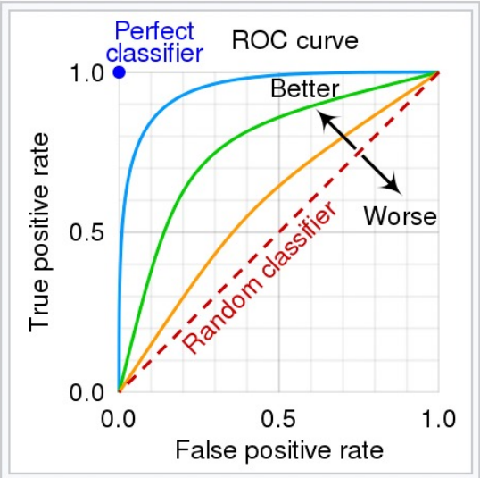
Benchmark for classification models
Confusion matrix
A confusion matrix, also called a 2*2 contingency table, compares the predicted class with the actual class.
ROC curve
A ROC (Receiver Operating Characteristics) curve is to measure the overall performance of a classification model under different thresholds.

Slide 17
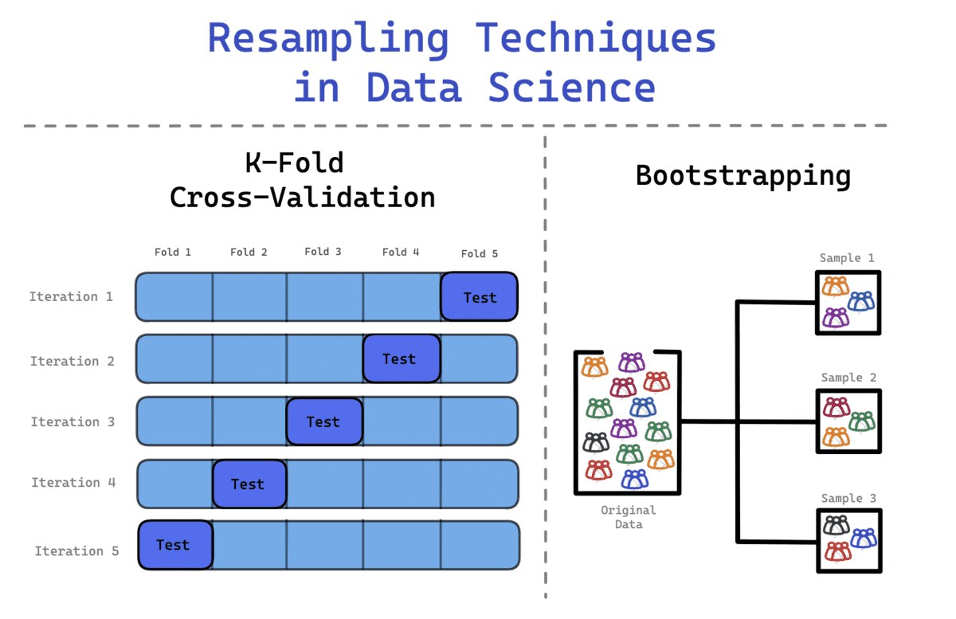
Resampling
The creation of new samples based on one observed sample. Resampling methods include permutation tests, bootstrapping, and cross validation.

Slide 18
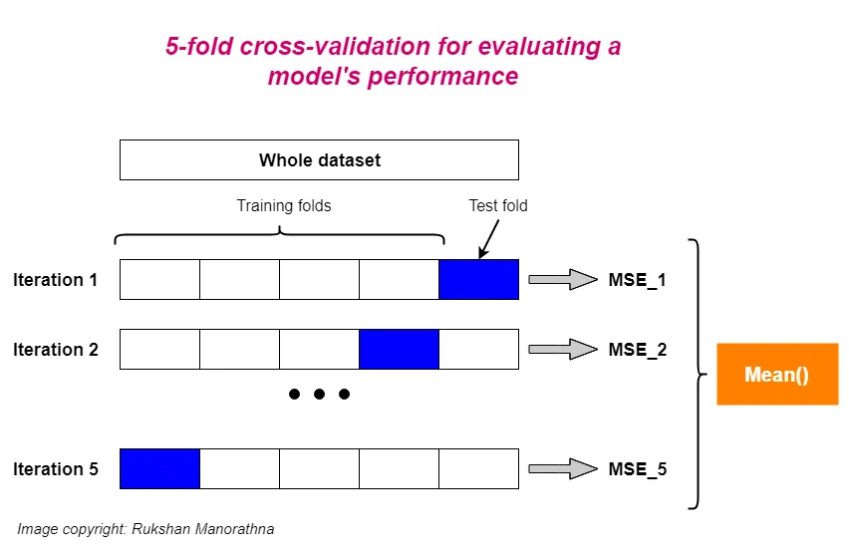
K-fold cross-validation
The whole dataset is randomly split into independent k-folds without replacement.
k-1 folds are used for the model training and one fold is used for performance evaluation.
This procedure is repeated k times (iterations) so that we obtain k number of performance estimates (e.g. MSE) for each iteration.
Then we get the mean of k number of performance estimates (e.g. MSE).

Slide 19
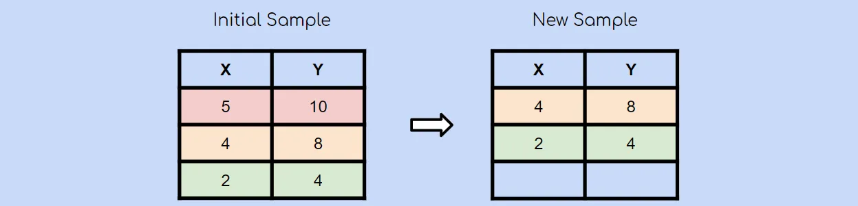
Bootstrap Sampling Method
The bootstrap sampling method is a resampling method that uses random sampling with replacement. Remember that bootstrap sampling using random sampling with replacement. This means that it is very much possible for an already chosen observation to be chosen again.

Slide 20
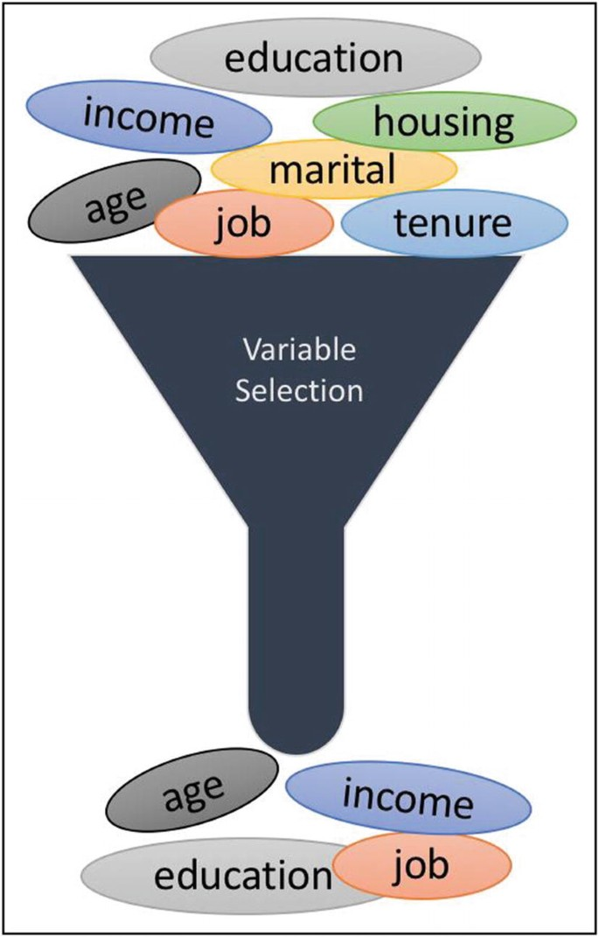
Variable Selection
In the field of machine learning, feature selection plays a crucial role in improving model performance, reducing computational complexity, and enhancing interpretability.

Slide 21
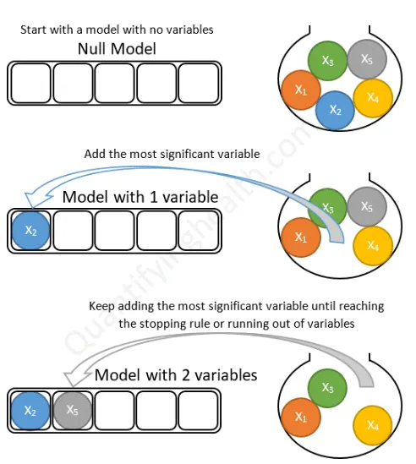
Forward selection
Forward Selection: Forward selection is an iterative method in which we start with having no feature in the model. In each iteration, we keep adding the feature which best improves our model till an addition of a new variable does not improve the performance of the model.

Slide 22
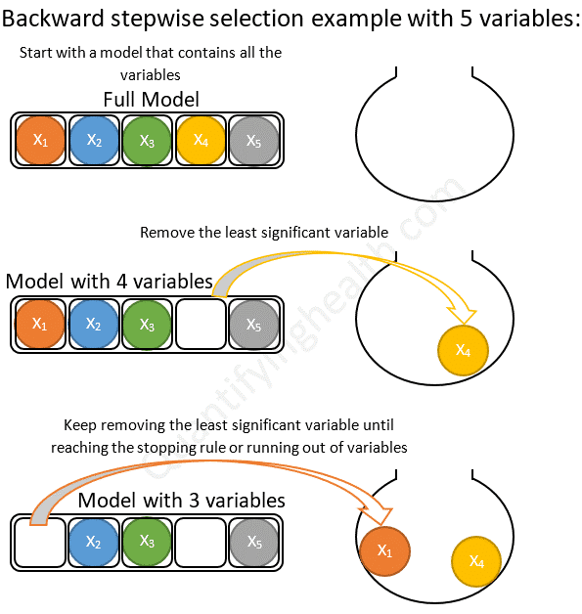
Backward elimination
In backward elimination, we start with all the features and removes the least significant feature at each iteration which improves the performance of the model. We repeat this until no improvement is observed on removal of features.

Slide 23
Shrinkage Methods
LASSO (Least Absolute Shrinkage and Selection Operator) (L1) is a linear regression technique that adds a penalty term to the ordinary least squares method. It minimizes the sum of squared errors while constraining the absolute values of the coefficients, promoting sparsity by driving some coefficients to exactly zero, aiding feature selection.
Ridge regression (L2) is a linear regression technique that introduces a regularization term to the ordinary least squares method. It minimizes the sum of squared errors while adding a penalty for large coefficient values, preventing overfitting. Ridge regression helps improve model stability by reducing the impact of multicollinearity in the data.

Slide 24
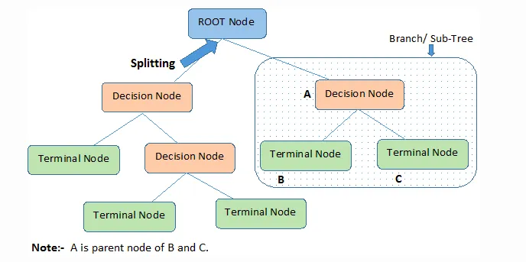
Tree-based methods
Tree-based methods are simple and intuitive; to predict a class label or value, we start from the top of the tree or the root and, using branches, go to the nodes by comparing features on the basis of which will provide the best split.

Slide 25
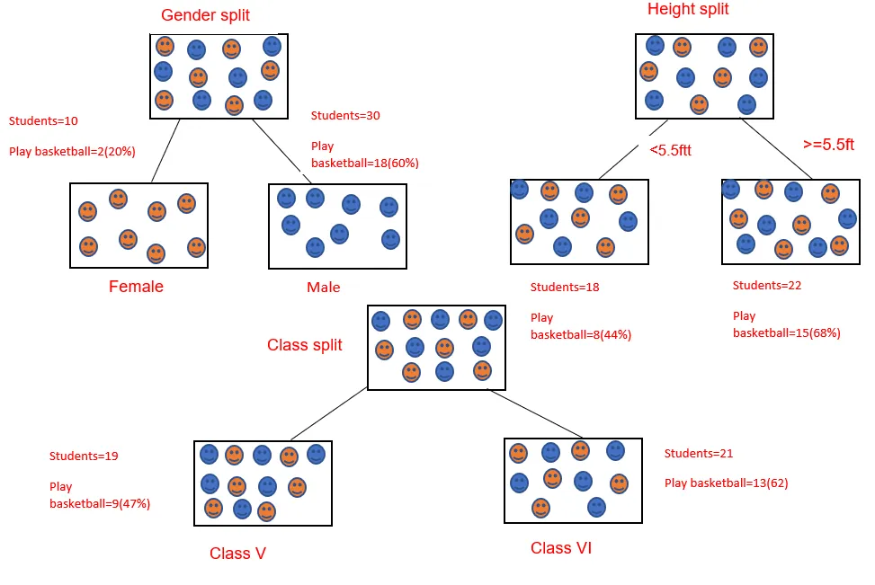
Decision Tree
A decision tree is a flowchart-like tree structure where each internal node denotes the feature, branches denote the rules and the leaf nodes denote the result of the algorithm. It is a versatile algorithm, which is used for both classification and regression problems.

Slide 26
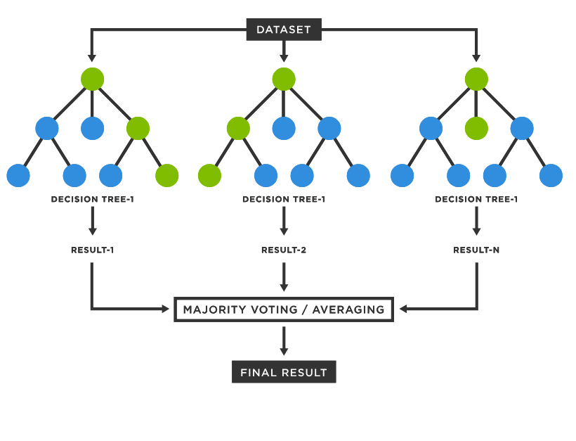
Random Forrest
The solution to the overfitting problem in Decision Trees is “ensembling” which basically means putting many weak trees together in a strong forest and getting predictions from each of the trees and taking a vote to decide on the winning prediction.

Slide 27
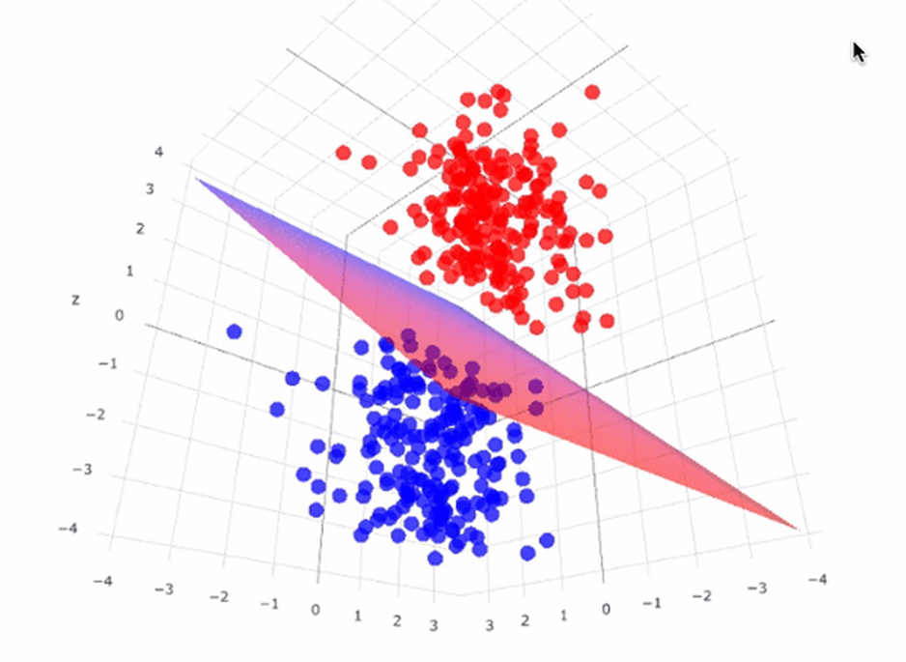
Support Vector Machine
The objective of the support vector machine algorithm is to find a hyperplane in an N-dimensional space (N is the number of features) that distinctly classifies the data points.

Slide 28
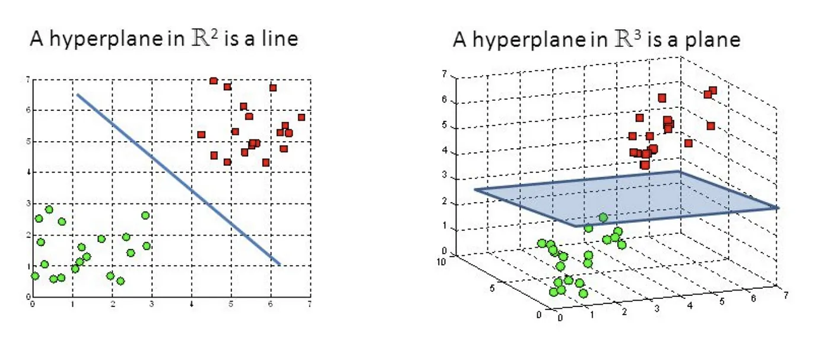
Support Vector Machine
Hyperplanes are decision boundaries that help classify the data points. Data points falling on either side of the hyperplane can be attributed to different classes. Also, the dimension of the hyperplane depends upon the number of features. If the number of input features is 2, then the hyperplane is just a line. If the number of input features is 3, then the hyperplane becomes a two-dimensional plane.

Slide 29
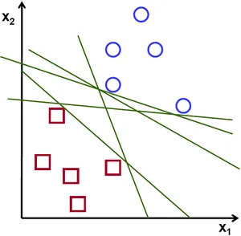
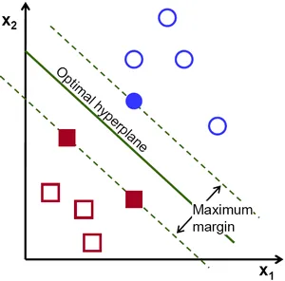
Support Vector Machine
To separate the two classes of data points, there are many possible hyperplanes that could be chosen. Our objective is to find a plane that has the maximum margin, i.e the maximum distance between data points of both classes. Maximizing the margin distance provides some reinforcement so that future data points can be classified with more confidence.

Slide 30
Question
Even with superior accuracy demonstrated in numerous benchmark tests, why do people opt for models like linear regression and random forest over support vector machines?

